Slide 1
POWER POINT PRESENTATION
By,
Ghaayadhri priyadharshine G R
CSD

Slide 2
COMPARISON
SCHOOL | COLLEGE
Gadgets not allowed | Gadgets allowed
Dress code: Uniform | Dress code:Ethinic wear
Board exam | Semester
School: VELALAR VIDHYALAYAA SENIOR SECONDARY SCHOOL | College:KONGU ENGINEERING

Slide 3
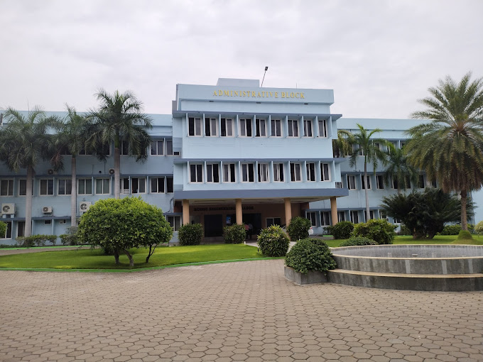

Slide 4
http://www.google.com

Slide 5
THANK YOU

